Slide 1
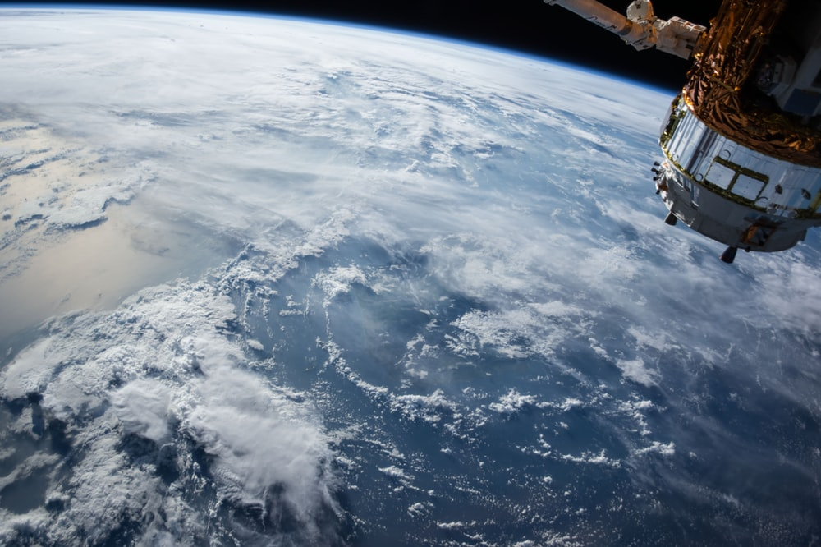

Copernicus Hackathon Training
University of Leicester

Slide 2

University of Leicester Training Agenda
(11.30) Overview of tools – Carmine Maffei
(12.00) Python for manipulation of geospatial data – John Roberts
(12.30) Group Allocations – Samad Ahmadi
(13.00) Networking Lunch and Q&A
(14.00) Event Closes
(10.00) Welcome – Arnaud Drapier
(10.05) Introduction to Hackathons and Rapid-MVP events – Samad Ahmadi
(10.30) Overview of challenge proposals (proposers)
(11.00) Overview of the Copernicus programme – Tim Trent & Carmine Maffei

Slide 3
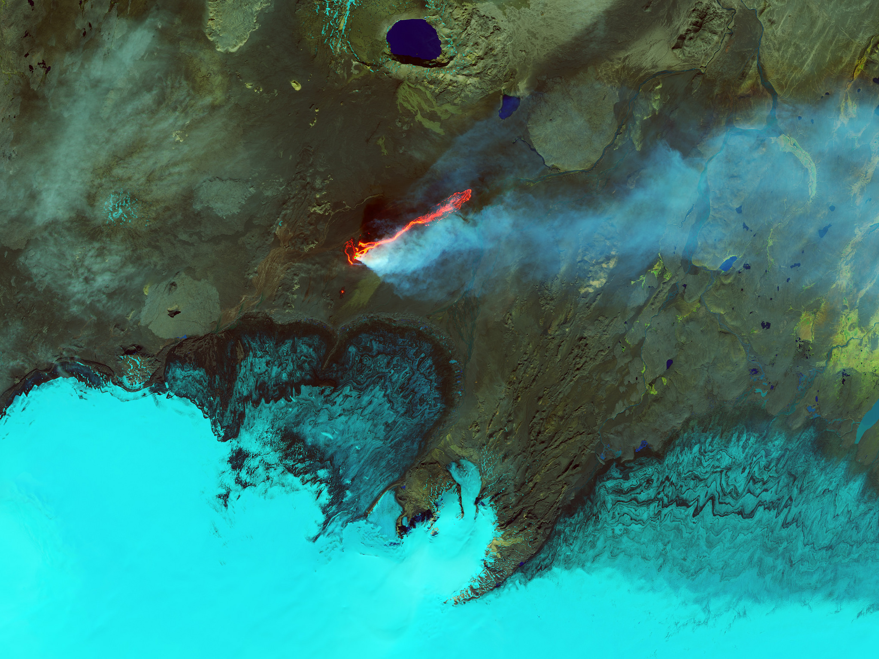
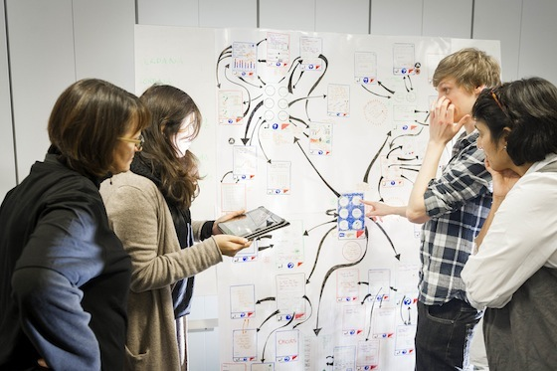
Copernicus Hackathon – University of Leicester
19th & 20th September
Intense problem solving and development event
Involving all stakeholders during the entire period to enable immediate feedback

Slide 4
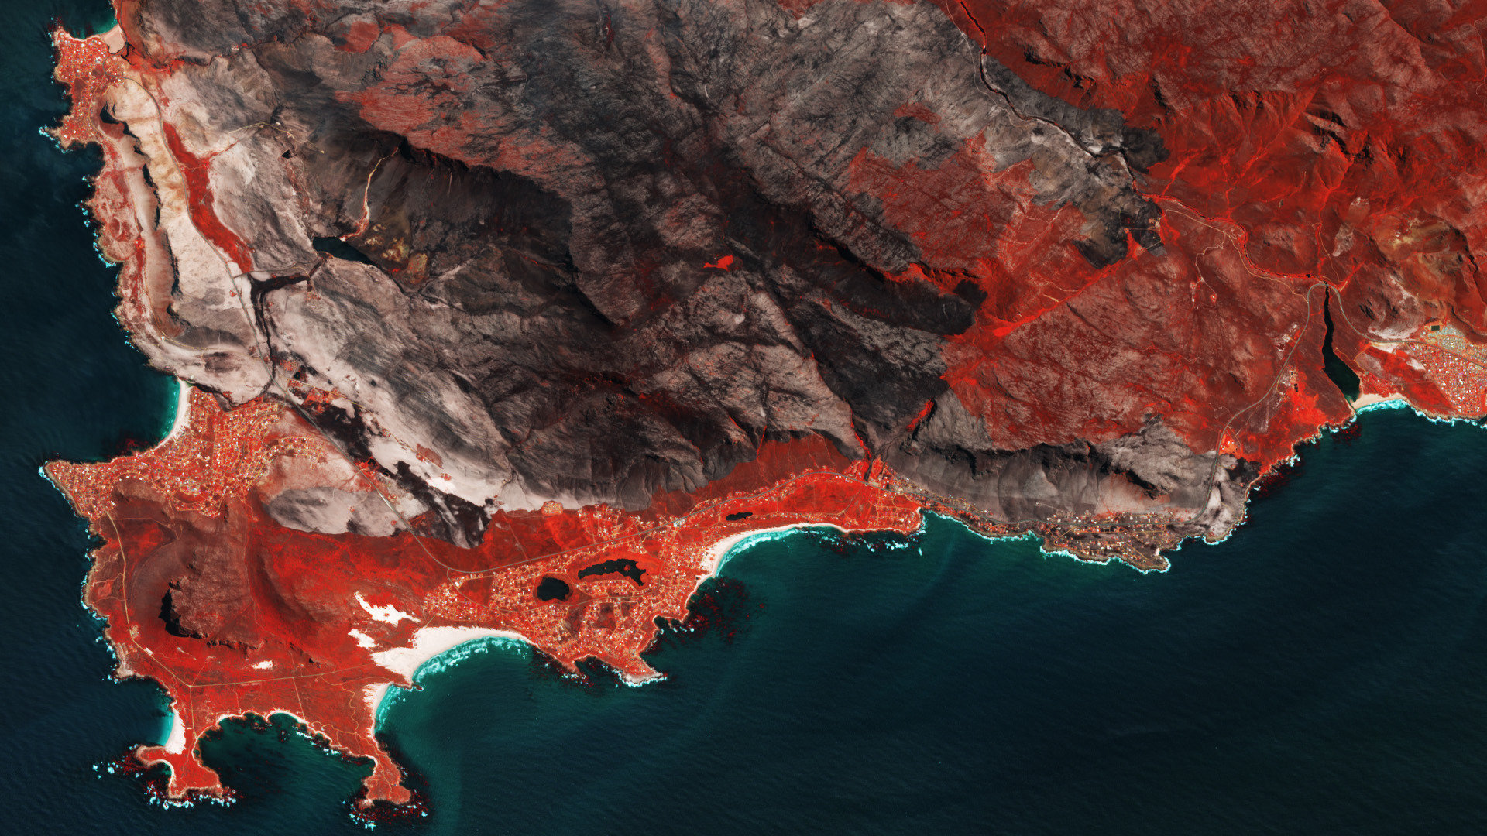
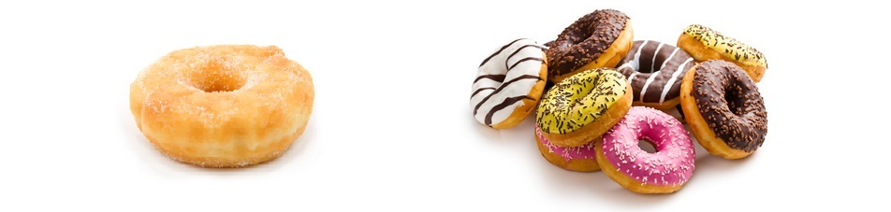
Structure of a Hackathon
1
Working together to understand the problem...
2
Identify an appropriate solution...
MVP
Product Vision
3
Identify a Minimum Viable Product (MVP) for proof of concept...
4
Use all the expertise present to develop the MVP!

Slide 5

Copernicus Hackathon Agenda
Day 1 – Thursday 19th
08:30 – Registration & Breakfast
09:10 – Kick off
09:45 – Project Proposals
10:15 – Teamwork: Identifying MVP
12:15 – Pitches
13:45 – Lunch
14:30 – Teamwork: coding, design, modelling
18:00 – Dinner break
19:30 – End of the first day
Day 2 – Friday 20th
08:30 – Breakfast
09:30 – Kick off
09:45 – Teamwork: coding, design, modelling
13:30 – Lunch
14:00 – Teamwork
16:30 – MVPs and project pitches
16:45 – Judges assessments
17:00 – Announcement of winning team
17:30 – End of Hackathon

Slide 6

Optimising Harvest Timing to Reduce Pre-Farm Gate Food Loss...
DESCRIPTION: reduce food waste through more effective prediction and better control of harvesting windows
IMPACT: This enables farmers to optimise their harvest time, reducing the risk of pre-farm gate food loss.
TECHNICAL SOLUTION: build a model for the upcoming year’s harvest, including climate information over the past year and weather forecasts for the harvest period giving the farmer the best date on which to harvest a given crop, within a window specified by the farmer.
Notes:
Innovative technologies and farming practices could make a significant impact on the goal of achieving net zero for the agriculture sector. Over a third of food produced globally is wasted each year (1.3Bn tonnes) and 51% of UK food wasted is pre-consumer (https://www.foodsecurity.ac.uk/publications/food-waste-within-global-food-systems.pdf). The UN has stated that if food waste was a country, it would be the 3rd largest emitting country in the world (http://www.fao.org/3/a-bb144e.pdf). The use of novel detection systems and predictive tools could assist in reducing food waste through more effective prediction and better control of harvesting windows and seasonality. Severe weather events and climate variability negatively impact agricultural yield and are expected to increase in the future. This tool or application would enable farmers to optimise their harvest time, reducing the risk of pre-farm gate food loss. It would incorporate farm yield data (could be inputted by the farmer, and compared to other farms using the Farm Business Survey data) and weather/climate information from previous years. It would then build a model for the upcoming year’s harvest, including climate information over the past year and weather forecasts for the harvest period (perhaps also satellite imaging information on the local geography), giving the farmer the best date on which to harvest a given crop, within a window specified by the farmer (based on when the crop is ready, using data on seed protein and water content etc.). These climate models would also warn the farmer of the risk of pest/disease outbreaks given certain weather conditions throughout the growing season, enabling farmers to take precautionary action.

Slide 7

Predicting wheat price fluctuations
DESCRIPTION: Develop a method to link wheat price in the UK and/or the stock prices of selected listed companies to natural catastrophes and/or changes in rainfall
IMPACT: This will help developing strategies to secure the stability of the food supply chain
TECHNICAL SOLUTION: Using open data and stock prices inputs to create a user-friendly dashboard
Notes:
Attached the Wheat prices up to today (source: https://uk.investing.com/commodities/london-wheat-historical-data
Another good source of information on wheat is https://www.igc.int/en/markets/marketinfo-prices.aspx France is one of the largest suppliers of wheat in the UK Wheat production is concentrated in the northern half of the country. The regions of Picardie, Centre, Champagne-Ardenne, Haute-Normandie and Nord-Pas-de-Calais account for a little over half of the French production, with 51% of the harvest. Another source is Argentina the area is the provence of Buenos Aires (they produce about 6,000/ha), Santa Fe and Cordoba. In this site you can see major wheat producers (including UK and France) https://ipad.fas.usda.gov/cropexplorer/cropview/comm_chartview.aspx?ftypeid=36&fattributeid=1&regionid=europe&cropid=0410000 Other map of wheat production can be seen at https://ipad.fas.usda.gov/rssiws/al/global_cropprod.aspxThis article has interesting information https://www.sciencedirect.com/science/article/pii/S221209471830121XOne of the questions is the SPEED and CORRELATION on what really happens inthe real economy and in the financial markets. Some examples of floods in wheat crops can be found at http://floodlist.com/?s=wheat&submit=
This is perfect for us. This is a challenge we really want to push to the participants. To proposed a self contained project and allow for a minimum viable product over the two days of the hackathon we would just need:
Data source for wheat prices (apologies, this is not in my field)
An event and its location in the last few years that caused a price fluctuation, a natural disaster or a famine occurring over months (I will check satellite data for this).

Slide 8
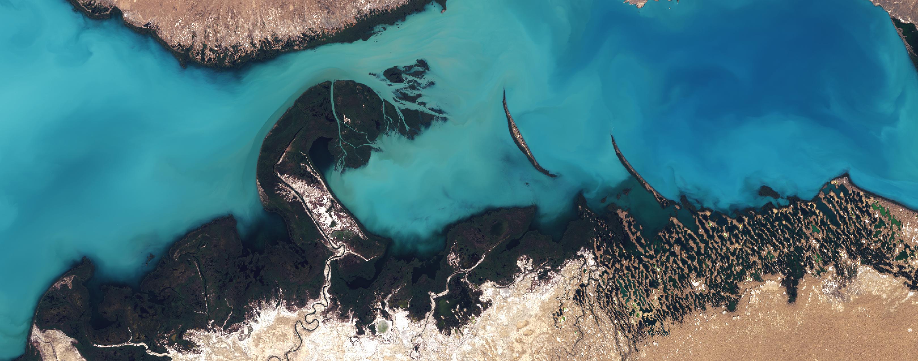
Identifying potential resources for bio-gas production...
DESCRIPTION: The main idea is to use satellite data to map unusable plant resources to improve the efficiency of bio-gas production.
IMPACT: This would improve bio-gas strategies for all over the world. It would provide better resources for local biogas farms.
TECHNICAL SOLUTION: A web application to show the map and quantity of bio-gas resources according to area and the user.
Notes:
The aim is to generate a tool which could be used by suppliers and consumers to calculate the environmental footprint of a food product. This could be used by any stakeholder in the food chain as a means to monitor and improve their use of environmentally-friendly food products. For example, industry could use it to buy more sustainable food products, label them as such (e.g. using a novel labelling system), and consumers could use it to inform buying decisions. This would also improve traceability and trust in food. This tool could start with GHG emissions, but could be extended to other environmental indicators (such as land use, biodiversity, land acidification, water eutrophication, freshwater use) to give an overall score. It could take the form of an application, and a novel and simple labelling system could include an additional QR code that consumers could access to get more information on the product.
In order to calculate the environmental footprint of a food product, the tool could incorporate the following data:
Farm of origin (data provided by food supplier), and any available information on farming practice used provided by the farm/supplier (e.g. organic, intensive)
Satellite data that would classify the type of farm and farming practice (e.g. free-range chickens or barn-reared, grass-fed cows or concentrated animal feeding operation (CAFO), agroforestry or extensive monoculture farms, extent of environmentally friendly practices (e.g. hedgerows, trees), if product if from land that has been deforested, etc).
Published estimates of environmental cost for particular food products and type of production system (available here)
Data on distance and means by which product has travelled to consumer (e.g. from brazil by aeroplane, provided by food supplier)

Slide 9
We look forward to see you all next week!

